Slide 1
CSC 2105::Data Structure Stack Application
Md. Kishor Morol
Lecturer, Department of Computer Science
Faculty of Science & Information Technology
American International University-Bangladesh (AIUB)
kishor@aiub.edu

Slide 2
Applications of Stack
Syntax parsing, Expression evaluation and Expression conversion.
Banking Transaction View
You view the last transaction first.
Backtracking and implementation of recursive function, calling function.
Towers of Hanoi
Inventory Systems like Issuing students the Multi-meters… you will be issued the most recently returned item likely

Slide 3
Algebraic Expression
An algebraic expression is a legal combination of operands and the operators.
Operand is the quantity (unit of data) on which a mathematical operation is performed.
Operand may be a variable like x,y,z or a constant like 5,4,0,9,1 etc.
Operator is a symbol which signifies a mathematical or logical operation between the operands. Example of familiar operators include +,-,*,/,^,%
Considering these definitions of operands and operators now we can write an example of expression as: x + y * z

Slide 4
Infix, Postfix and Prefix Expressions
INFIX: The expressions in which operands surround the operator, i.e. operator is in between the operands. e.g. x+y, 6*3 etc. The infix notation is the general way we write an expression.
POSTFIX: Also Known as Reverse Polish Notation (RPN). The operator comes after the operands, i.e. operator comes post of the operands, so the name postfix. e.g. xy+, xyz+* etc.
PREFIX: Also Known as Polish notation. The operator comes before the operands, i.e. operator comes pre of the operands, so the name prefix. e.g. +xy, *+xyz etc.

Slide 5
Infix
To our surprise INFIX notations are not as simple as they seem specially while evaluating them. To evaluate an infix expression we need to consider Operators’ Precedence and Associative property
For example expression 3+5*4 evaluate to
32 = (3+5)*4
or
23 = 3+(5*4)
Operator precedence and associativity governs the evaluation order of an expression.
An operator with higher precedence is applied before an operator with lower precedence.
Same precedence order operator is evaluated according to their associativity order.

Slide 6
Infix
To our surprise INFIX notations are not as simple as they seem specially while evaluating them. To evaluate an infix expression we need to consider Operators’ Precedence and Associative property
For example expression 3+5*4 evaluate to
32 = (3+5)*4 - Wrong
or
23 = 3+(5*4) - Correct
Operator precedence and associativity governs the evaluation order of an expression.
An operator with higher precedence is applied before an operator with lower precedence.
Same precedence order operator is evaluated according to their associativity order.

Slide 7
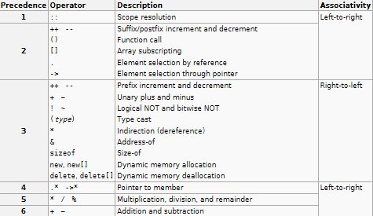
Operator Precedence and Associativity

Slide 8
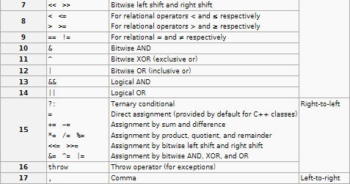
Operator Precedence and Associativity

Slide 9
Infix Expression Is Hard To Parse
Need operator priorities, tie breaker, and delimiters.
This makes the evaluation of expression more difficult than is necessary for the processor.
Both prefix and postfix notations have an advantage over infix that while evaluating an expression in prefix or postfix form we need not consider the Precedence and Associative property.
The expression is scanned from user in infix form; it is converted into prefix or postfix form and then evaluated without considering the parenthesis and priority of the operators.
So, it is easier (complexity wise) for the processor to evaluate expressions that are in these forms.

Slide 10
Examples of infix to prefix and postfix
Infix | PostFix | Prefix
A+B | AB+ | +AB
(A+B) * (C + D) | AB+CD+* | *+AB+CD
A-B/(C*D^E) | ABCDE^*/- | -A/B*C^DE
A
-
B
/
(
C
*
D
^
E
)
A
B
C
D
E
^
*
/
-
-
A
/
B
*
C
^
D
E
A
-
B
/
(
C
*
F
)
A
B
C
F
*
/
-
D
^
E
-
A
/
B
*
C
F
D
^
E
A
-
B
/
G
A
B
G
/
-
C
*
F
-
A
/
B
G
C
*
F
A
-
H
A
H
-
B
/
G
-
A
H
B
/
G
I
I
A
-
H
I
A
-
H

Slide 11
Converting Infix to Postfix
Infix Expression: 2*6/(4-1)+5*3
Add ')' to the end of Infix; Push( '(' );
do{
OP = next symbol from left of Infix;
if OP is OPERAND then EnQueue( OP );
else if OP is OPERATOR then{
if OP = '(' then Push( OP );
else if OP = ')' then{
while StackOperator != '(' do{
Enqueue( Stackoperator );
Pop( StackOperator );
}
Pop( StackOperator );
}else{
while Precedence( OP ) <= Precedence( TopElement( ) ) do{
Enqueue( StackOperator );
Pop( StackOperator );
}
Push( OP );
}
}while !IsEmpty();
)
+
2
4
-
)
+
2
4
-
1
/
1
/
)
Infix
*
6
(
5
*
3
)
*
6
(
5
*
3
Postfix
2
6
*
4
1
-
/
5
3
*
+
Stack
(
+
*
/
(
*
-
OPERATOR
OPERAND
End of Expression
/ = StackTop( * )
* ≥ StackTop( ( )
/ ≥ StackTop( ( )
(
)
+ < StackTop( / )
+ ≥ StackTop( ( )
* ≥ StackTop( + )
- ≥ StackTop( ( )

Slide 12
Evaluating Postfix Expression
6
6
*
*
4
4
1
1
-
-
/
/
5
5
3
3
*
*
+
+
)
2
)
Postfix
2
Postfix Expression: 26*41-/53*+
EnQueue( ')' );
while ( FrontElement() != ')' ) do{
OP = FrontElement();
DeQueue();
if OP is OPERAND then Push( OP );
else if OP is OPERATOR then{
OperandRight = TopElement();
Pop();
OperandLeft = TopElement();
Pop();
x = Evaluate(OperandLeft, OP, OperandRight);
Push(x);
}
}
Result = TopElement();
Pop();
cout << Result;
Stack
2
6
1
12
4
19
4
3
5
15
3
OPERATOR
OPERAND
Evaluate( 2, '*', 6 ) = 12
Evaluate( 4, '+', 15 ) = 19
‘)‘
Evaluate( 5, '*', 3 ) = 15
Evaluate( 12, '/', 3 ) = 4
Evaluate( 4, '-', 1 ) = 3
End of Expression
Expression Result = 19

Slide 13
Reverse the given Infix Expression;
Reverse the parentheses: if ‘(‘ then ‘)’; if ‘)’ then ‘(‘;
Add ')' to the end of Infix; Push( '(' );
do{
OP = next symbol from left of Infix;
if OP is OPERAND then EnQueue( OP );
else if OP is OPERATOR then{
if OP = '(' then Push( OP );
else if OP = ')' then{
while StackOperator != '(' do{
Enqueue( Stackoperator );
Pop( StackOperator );
}
Pop( StackOperator );
}else{
while Precedence( OP ) > Precedence( TopElement( ) ) do{
Enqueue( StackOperator );
Pop( StackOperator );
}
Push( OP );
}
}while !IsEmpty();
Infix to Prefix Algorithm/ PseudoCode

Slide 14
Evaluating Prefix Expression
EnQueue( ')' ); /* adds ‘)’ at the end of prefix expression */
while ( FrontElement() != ')' ) do{
OP = FrontElement();
DeQueue();
if OP is OPERAND then Push( OP );
else if OP is OPERATOR then{
OperandLeft = TopElement();
Pop();
OperandRight = TopElement();
Pop();
x = Evaluate(OperandLeft, OP, OperandRight);
Push(x);
}
}
Result = TopElement();
Pop();
cout << Result;

